Slide 1
Mobile Training Team Support Requirements
1st Battalion, 29th Infantry Regiment
COMBATIVES MASTER TRAINER COURSE

Slide 2
1st Battalion, 29th Infantry Regiment
• Overview
• Cadre Support
• Host Unit Support
– Equipment
– Facilities
• Example Training Schedule
• Publications and Materials
• Other Requirements
• Point of Contact

Slide 3
1st Battalion, 29th Infantry Regiment
• United States Army Combatives Course (USACC)
creates master trainers who will be able to certify Basic and Tactical Combatives Course (Level I-II), integrate Combatives into METL training, and referee standard, intermediate, Advanced and Tactical rule competitions.
• Training includes: Basic Combatives Course (Level I),
review, Tactical Combatives Course (Level II) review,
Boxing, Kickboxing, San Shou, Wrestling takedowns,
impact suit training, standard rules and tournament
class, ground fighting, weapons training, intermediate, Advanced, Tactical rules class, and practical exercise.

Slide 4
1st Battalion, 29th Infantry Regiment
• USACC MTT Cadre will provide the following:
Certified Combatives Instructors for a minimum of 12 with a
maximum of 36 students.
Course training schedule and material to include:
– Boxing
– Kickboxing
– San Shou
– Impact suit training
– Weapon training
– Scenario base-training

Slide 5
1st Battalion, 29th Infantry Regiment
Host unit will provide the following:
Facilities: Must have matted area of 8 SQF per Soldier. For
a class size of 36 that would be 2304 SQF of
matted area. The building needs to be climate
controlled and have bathrooms with running
water.
Equipment: Installations are to have all equipment stated
in the MOI. Students need to have four sets
of ACU/OCP, no less than five tan or green colored
shirts, one complete set of PT’s (seasonal), four sets
pt. shorts, boxing hand wraps (180inch), mouth piece and groin protection. Soldier will bring ACH, MICH, or helmet, Body Armor, Gloves, Elbow and Knee Pad, Eye Protection, and Camelback. Wrestling shoes are authorized for portions of the course.

Slide 6
1st Battalion, 29th Infantry Regiment
• Publications:
– AR 350-1 Army Leader and Development
– TC 3-25.150 Combatives Manual (2017)
• Materials:
– Blank white paper to reproduce bout sheets
– Study packets (1 per student)
– Pens/ Black markers
– Pencils

Slide 7
1st Battalion, 29th Infantry Regiment
• Host unit will provide a senior E-6 with to serve as LNO between
host unit and USACC
• Students are not allowed to miss more than 2 hours of training per
Week
• Students will not be assigned any type of duty or have any type of
appointments while at training (PT, Staff duty, leave, etc…)
• School NCOs' must enroll students 30 days prior to start date
• Students must not be on temp/permanent profile that will hinder
combatives training

Slide 8
1st Battalion, 29th Infantry Regiment
• Company Commander
CPT Allen
901-305-5062
• Company 1SG
1SG Byington
315-222-6769
• Branch Chief
SFC Farris
706-544-5259
• Course Operations
SFC Cortez
254-338-9510 / 706-544-5259

Slide 9
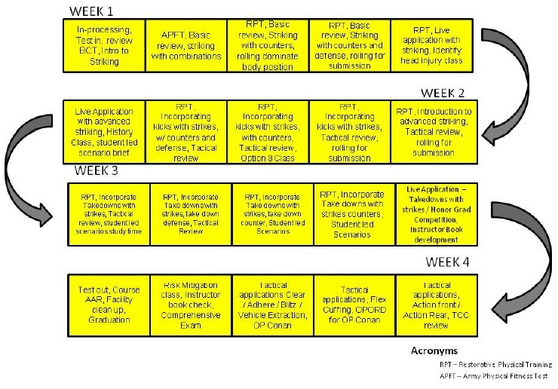
1st Battalion, 29th Infantry Regiment

